Slide 1
Lesson 01.10 - Collision Detection
How do we detect collision between characters?

Slide 2
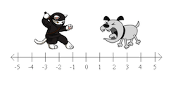
Distance along one axis -> 1D Distance
How far apart are the cat and the dog?

Slide 3
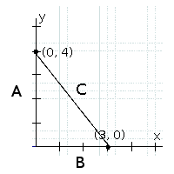
2D Distance -> Pythagorean Theorem
How could you find the length of line C?

Slide 4
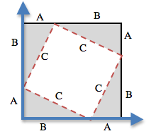
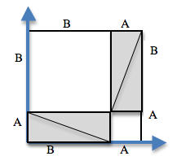
2D Distance -> Pythagorean Theorem
How could you find the length of line C?

Slide 5
2D Distance -> Pythagorean Theorem
How could you find the length of line C?
To get C by itself, we take the square-root of the sum of the areas:
√(A²+B²) = C

Slide 6
2D Distance -> Pythagorean Theorem
In Pyret:
num-sqrt(num-sqr(A) + num-sqr(B))
To get C by itself, we take the square-root of the sum of the areas:
√(A²+B²) = C

Slide 7
Line-length
## line-length : number number -> number
## Finds 1D distance
fun line-length(num1 :: Number, num2 :: Number) -> Number:
ask:
| num1 > num2 then: num1 - num2
| num2 >= num1 then: num2 - num1
end
end

Slide 8
Distance
## distance : number number number number -> number
## Finds the 2D distance between two points
fun distance(x1 :: Number, y1 :: Number, x2 :: Number, y2 :: Number) -> Number:
num-sqrt(num-sqr(line-length(x1, x2)) + num-sqr(line-length(y1, y2)))
end

Slide 9
Collide
## collide : number number number number -> boolean
## determines whether two objects are within 50 pixels of each other
fun collide(x1, y1, x2, y2):
distance(x1, y1, x2, y2) < 80
end

